Slide 1
INTRODUCTION TO PROGRAMMING IN PYTHON

Slide 2
TOPICS
What is a program?
First program in Python
Types of values in Python
Boolean expressions and logical operators
Conditional expressions
Loops
Functions
Example Roboloco code

Slide 3
INTRODUCTION
What is a program?

Slide 4
What is a program?
A program is a set of instructions that describes how to perform a certain computation
Key features (in any programming language)
Input: getting data from a source (file, device etc.)
Output: displaying data after some computation and saving in an output file
Mathematical operations (part of computation)
Conditional execution: checking for certain conditions and running the code

Slide 5
PYTHON
First Program in Python

Slide 6
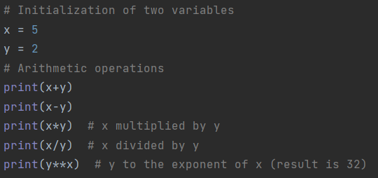
First program in Python
Print statement: displaying result (e.g. text) on the screen
Any statement in a row starting with # represents a comment and is not executed as code
Arithmetic operators: performing computations (+,-,*,/ and ** as exponent)

Slide 7
PYTHON
Values and Types

Slide 8
Values and types
Values: individual data items, like numbers or letters e.g. 12, 12.3, ‘robot’
Each value has a type e.g. integer, string, floating number
You can retrieve the type of a value with the simple command type:
Input:
Output (corresponding to each row)

Slide 9
PYTHON
Boolean expressions and logical operators

Slide 10
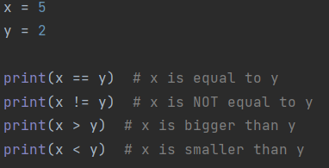
Boolean expressions and logical operators
A boolean expression is an expression that is either True or False
Some relational operators that can be used to check if an expression is true or not:
Input: Output:
True and False have a type boolean (not string!):

Slide 11
PYTHON
Conditional expressions

Slide 12
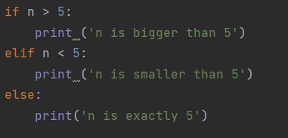
Conditional expressions
A conditional expression checks if a statement is True or False; if the expression is True, the indented statement runs and if not, nothing happens:
Input Output:
Next, we have nested conditions which are run if the first condition is False. The other conditions are indicated by elif (else if) and else, which is run when all previous conditions are False:
Input: Output:

Slide 13
PYTHON
Loops

Slide 14
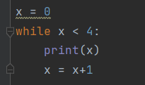
Loops
A loop runs the code in the indented space as long as a condition is True; A loop can be executed with the command while:
Input: Output:
A for statement can also execute a loop. Here is the previous example using ‘for’:
Input: Output

Slide 15
PYTHON
Functions

Slide 16
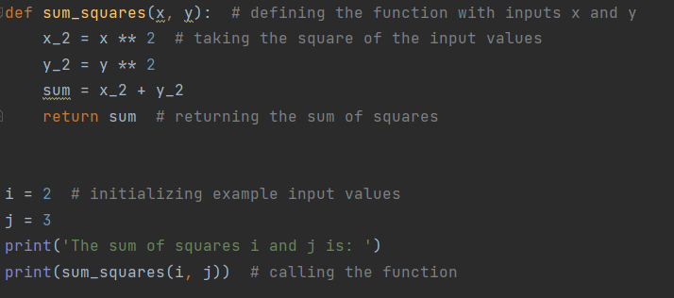
Functions
In programming, a function is a defined sequence of statements to perform computations
You define a function by specifying a name and the sequence of statements inside the indentation. Later, you can call the function by its name.
In the next example, we define a function that takes two input values and calculates the sum of their squares. Then, we call the function for to display the result:
Input: Output:

Slide 17
PYTHON
Example Roboloco code

Slide 18
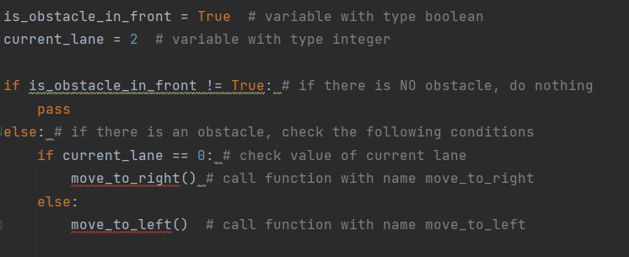
Example RoboLoco code
In the following example, we define two variables and check several conditions:
The functions move_to_right and move_to_left (not defined in this code) do not take input values
Which function would be executed after running this code?
Notes:
Answer: move_to_left()

Slide 19
THANK YOU
https://teducativas.madeira.gov.pt/roboloco

